Slide 1
UPPER SIXTH ARTS
GEOGRAPHY
Quantitative Techniques 3 (Part 2)
Measures of Dispersion: Variance, Standard Deviation and Coefficient of Variation
Notes:
Good morning, class, and welcome to our geography lesson. I am your geography teacher, Mr Kamdem. Today we are starting Quantitative Techniques 3 (Part 2): Measures of Dispersion: Variance, Standard Deviation and Coefficient of Variation.

Slide 2
CLASS INFO
Class, Chapter and Duration
Class | Upper Sixth Arts
Chapter | Module 8: Understanding and carrying out statistical techniques, topographic map analysis, fieldwork and project based learning
Duration | 2 periods (2 × 50 minutes)
Notes:
This lesson is for Upper Sixth Arts. It belongs to Module 8: Understanding and carrying out statistical techniques, topographic map analysis, fieldwork and project based learning. We shall need 2 periods to cover it.

Slide 3
IDENTIFICATION
Lesson Identification
Topic | Quantitative Techniques in Geography
Sub-topic | Statistical Techniques
Lesson | Quantitative Techniques 3 (Part 2): Measures of Dispersion: Variance, Standard Deviation and Coefficient of Variation
Notions / Concepts | Dispersion, deviation, variance, standard deviation, coefficient of variation, population (σ), sample (s).
Syllabus focus | Variance: meaning, formula and calculation; standard deviation: steps and worked examples; coefficient of variation.
Competence | Learners are able to calculate and interpret the variance, standard deviation and coefficient of variation of geographical data.
Notes:
Our topic is Quantitative Techniques in Geography, and the sub-topic is Statistical Techniques. The key notions we shall use today are: dispersion, deviation, variance, standard deviation, coefficient of variation, population (σ), sample (s). At the end, you should be able to do this: learners are able to calculate and interpret the variance, standard deviation and coefficient of variation of geographical data.

Slide 4

HOMEWORK CORRECTION
Correction of the Homework
Question (Quantitative Techniques 3 (Part 1): Measures of Central Tendency, Range and Quartiles):
Calculate the mean of 3, 5, 7 and 9.
Notes:
Before we start the new lesson, let us correct the homework I gave you at the end of Quantitative Techniques 3 (Part 1): Measures of Central Tendency, Range and Quartiles. The question was: Calculate the mean of 3, 5, 7 and 9. Take out your exercise books.

Slide 5
HOMEWORK CORRECTION
Correction: Possible Answer
(3 + 5 + 7 + 9) ÷ 4 = 24 ÷ 4 = 6.
Notes:
Here is a good answer. (3 + 5 + 7 + 9) ÷ 4 = 24 ÷ 4 = 6. Compare it with your own answer and correct your work in red.

Slide 6
LESSON PLAN
Lesson Plan
Correction of the homework
Objectives and recall
Real-life situation and action to take
Learning activities
Board summary
Evaluation, remediation and homework
Notes:
Here is the plan of our lesson today. First, we shall correct the homework. Then we shall look at the objectives and recall what you already know. After that, we shall study a situation from real life and the action to take, and do the learning activities. Finally, we shall copy the board summary, do the evaluation and the remediation, and I will give you the homework.

Slide 7
OBJECTIVES
Objectives
By the end of this lesson, you should be able to:
Define dispersion and variance.
Calculate the variance.
Calculate the standard deviation step by step.
Notes:
Take your time to copy this part; we will continue together.

Slide 8
OBJECTIVES
Objectives (continued)
Calculate and interpret the coefficient of variation.
Notes:
By the end of this lesson, you should be able to do four things. Number 1: define dispersion and variance. Number 2: calculate the variance. Number 3: calculate the standard deviation step by step. Number 4: calculate and interpret the coefficient of variation.

Slide 9
PREVIOUS KNOWLEDGE
Previous Knowledge
Mean = Σx ÷ n.
The range uses only two values.
The IQR ignores outliers.
Notes:
Let us first remember what you already know. Mean = Σx ÷ n. The range uses only two values. The IQR ignores outliers. Keep this in mind, because we shall build on it today.

Slide 10
REAL-LIFE SITUATION
Situation in Real Life
Two farmers near Garoua both harvest an average of 20 bags of maize a year.
Over five years, the first harvested 19, 20, 21, 20 and 20 bags, while the second harvested 5, 35, 12, 30 and 18 bags.
The bank must lend money to the more reliable farmer.
Notes:
Take your time to copy this part; we will continue together.

Slide 11
REAL-LIFE SITUATION
Situation in Real Life (continued)
The bank officer asks: "The averages are the same, so how can we measure which harvest varies more?"
Notes:
Listen carefully to this situation from real life. Two farmers near Garoua both harvest an average of 20 bags of maize a year. Over five years, the first harvested 19, 20, 21, 20 and 20 bags, while the second harvested 5, 35, 12, 30 and 18 bags. The bank must lend money to the more reliable farmer. The bank officer asks: "The averages are the same, so how can we measure which harvest varies more?" Think about it, because I am going to ask you some questions.

Slide 12
REAL-LIFE SITUATION
Situation: Question 1
What is the problem in the situation?
Notes:
Question 1: What is the problem in the situation? Think for a moment, then raise your hand to answer.

Slide 13
REAL-LIFE SITUATION
Answer
The officer does not know how to measure the spread of data around the mean.
Notes:
Good. The officer does not know how to measure the spread of data around the mean.

Slide 14
REAL-LIFE SITUATION
Situation: Question 2
Whose harvests are more regular?
Notes:
Question 2: Whose harvests are more regular? Think for a moment, then raise your hand to answer.

Slide 15
REAL-LIFE SITUATION
Answer
The first farmer's.
Notes:
Good. The first farmer's.

Slide 16
REAL-LIFE SITUATION
Situation: Question 3
Which measure uses every value to show spread?
Notes:
Question 3: Which measure uses every value to show spread? Think for a moment, then raise your hand to answer.

Slide 17
REAL-LIFE SITUATION
Possible Answer
The standard deviation.
Notes:
Good. The standard deviation.

Slide 18
ACTION TO TAKE
Action to Take
Use the standard deviation and coefficient of variation to compare the reliability of rainfall or harvests.
Notes:
From this situation, the action we are working towards in this lesson is the following: use the standard deviation and coefficient of variation to compare the reliability of rainfall or harvests.

Slide 19
JUSTIFICATION
Justification of the Lesson
This lesson gives the most important measures of spread used in geography, for rainfall, yields, temperatures and populations.
Notes:
Why is this lesson important for you? This lesson gives the most important measures of spread used in geography, for rainfall, yields, temperatures and populations.

Slide 20
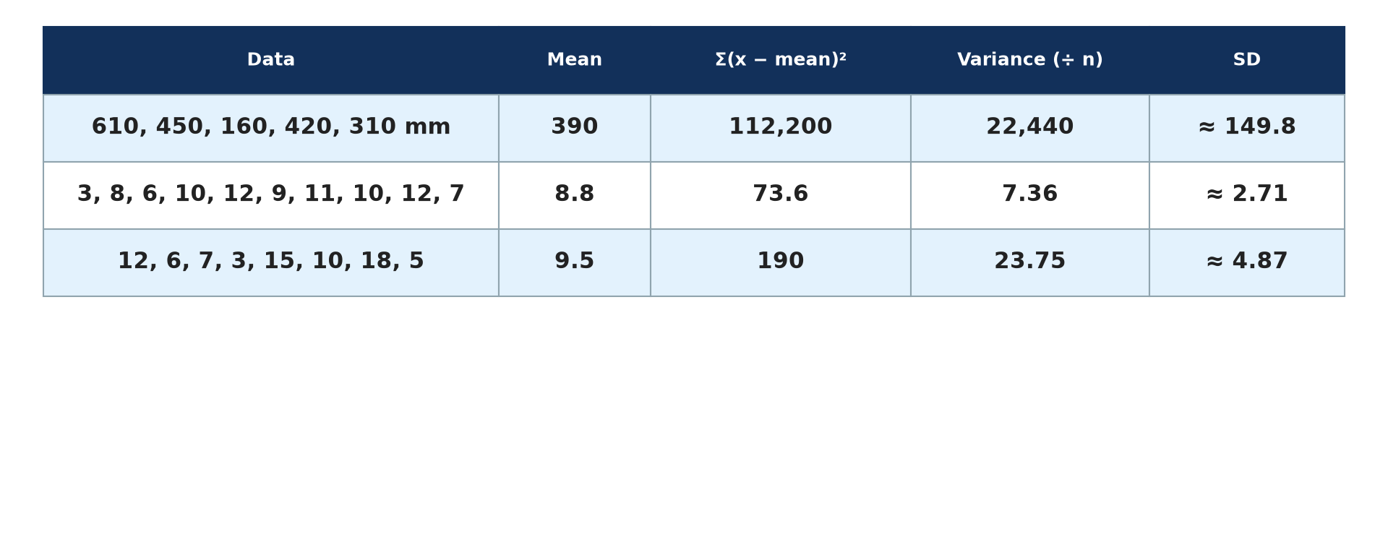
1. VARIANCE
Activity 1
Variance worked examples.
Notes:
Activity 1. Look carefully at this picture: variance worked examples. Observe every detail before I ask the question.

Slide 21
1. VARIANCE
Activity 1: Question
What is the first step in calculating the variance?
Notes:
Here is the question for Activity 1: What is the first step in calculating the variance? Take one minute to think and write your answer in your rough notebook.

Slide 22
1. VARIANCE
Activity 1: Answer
Calculate the mean.
Notes:
Let us check the answer together. Calculate the mean.

Slide 23
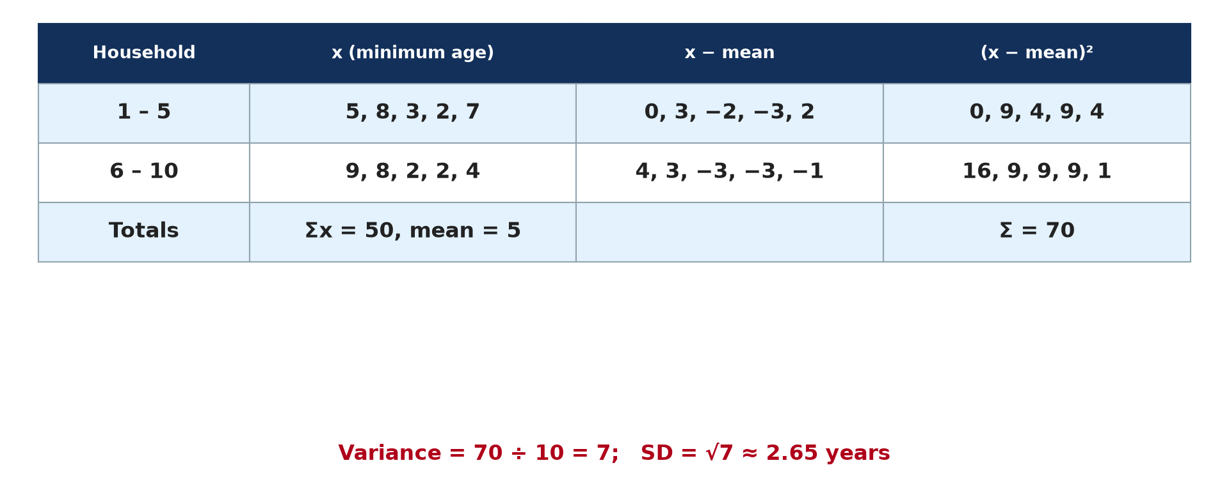
2. STANDARD DEVIATION
Activity 2
Standard deviation of household ages.
Notes:
Activity 2. Look carefully at this picture: standard deviation of household ages. Observe every detail before I ask the question.

Slide 24
2. STANDARD DEVIATION
Activity 2: Question
If the variance is 7, what is the standard deviation?
Notes:
Here is the question for Activity 2: If the variance is 7, what is the standard deviation? Take one minute to think and write your answer in your rough notebook.

Slide 25
2. STANDARD DEVIATION
Activity 2: Answer
√7 ≈ 2.65.
Notes:
Let us check the answer together. √7 ≈ 2.65.

Slide 26
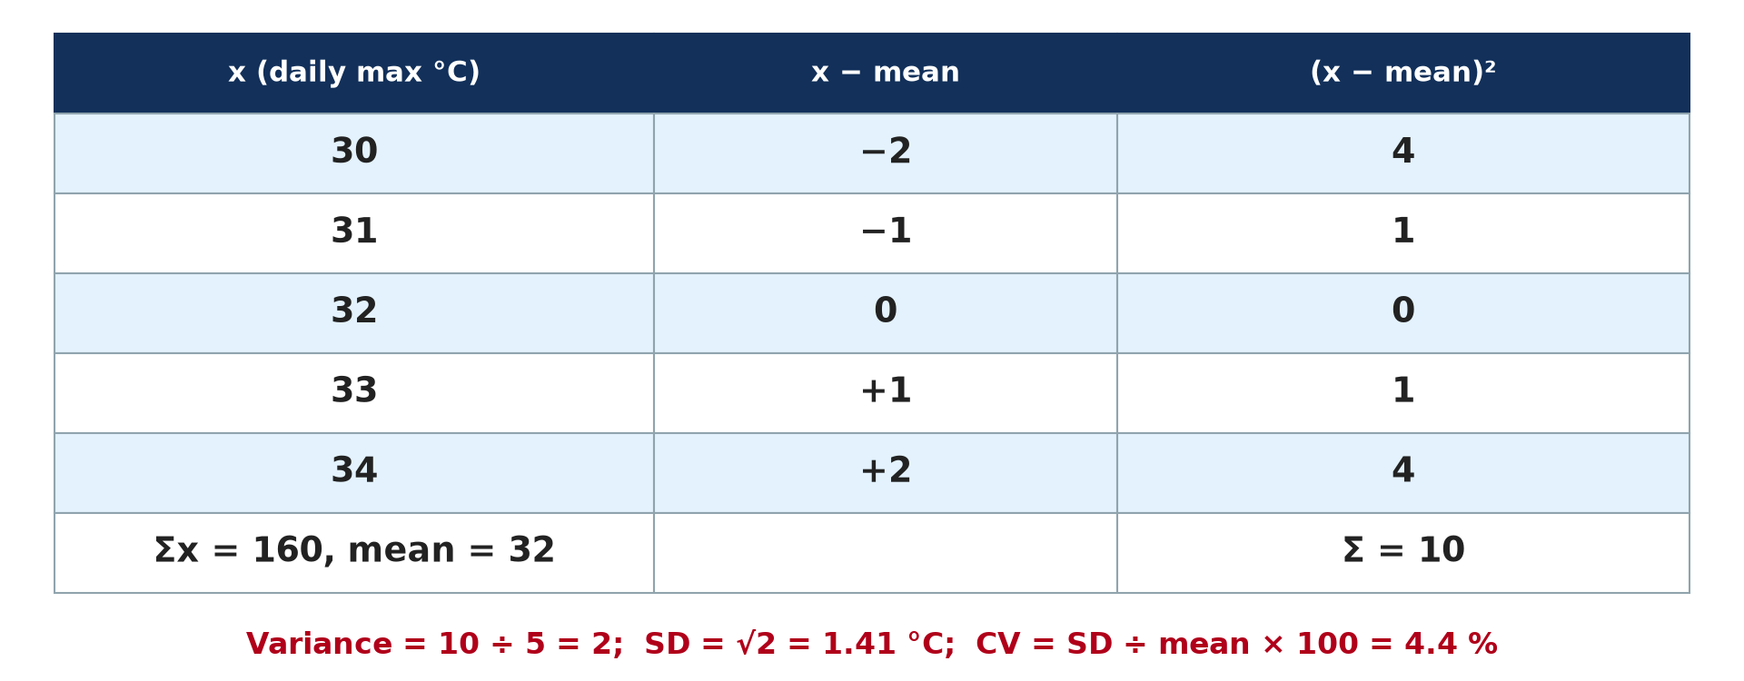
2. STANDARD DEVIATION
Activity 3
A standard deviation table.
Notes:
Activity 3. Look carefully at this diagram: a standard deviation table. Observe every detail before I ask the question.

Slide 27
2. STANDARD DEVIATION
Activity 3: Question
Why are the deviations squared?
Notes:
Here is the question for Activity 3: Why are the deviations squared? Take one minute to think and write your answer in your rough notebook.

Slide 28
2. STANDARD DEVIATION
Activity 3: Answer
To remove the negative signs.
Notes:
Let us check the answer together. To remove the negative signs.

Slide 29
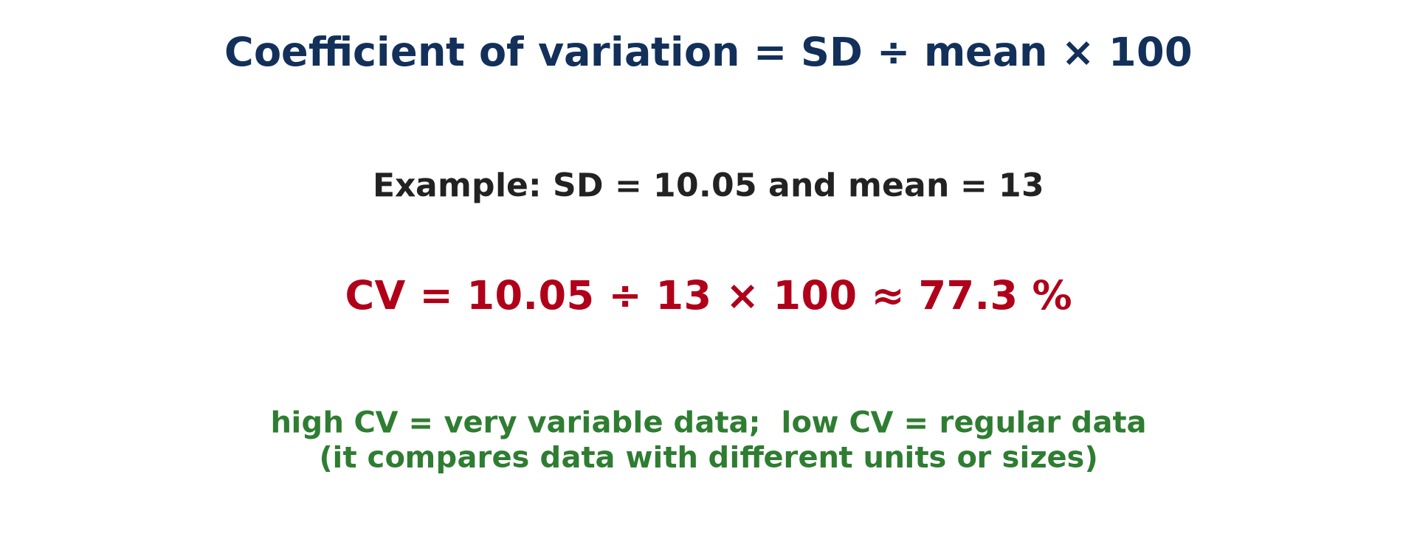
3. COEFFICIENT OF VARIATION
Activity 4
The coefficient of variation.
Notes:
Activity 4. Look carefully at this picture: the coefficient of variation. Observe every detail before I ask the question.

Slide 30
3. COEFFICIENT OF VARIATION
Activity 4: Question
Calculate the CV if SD = 10.05 and mean = 13.
Notes:
Here is the question for Activity 4: Calculate the CV if SD = 10.05 and mean = 13. Take one minute to think and write your answer in your rough notebook.

Slide 31
3. COEFFICIENT OF VARIATION
Activity 4: Answer
10.05 ÷ 13 × 100 ≈ 77.3 %.
Notes:
Let us check the answer together. 10.05 ÷ 13 × 100 ≈ 77.3 %.

Slide 32

3. COEFFICIENT OF VARIATION
Activity 5
The climate of Garoua.
Notes:
Activity 5. Look carefully at this diagram: the climate of Garoua. Observe every detail before I ask the question.

Slide 33
3. COEFFICIENT OF VARIATION
Activity 5: Question
Would monthly rainfall in Garoua have a high or low CV?
Notes:
Here is the question for Activity 5: Would monthly rainfall in Garoua have a high or low CV? Take one minute to think and write your answer in your rough notebook.

Slide 34
3. COEFFICIENT OF VARIATION
Activity 5: Answer
High: some months have almost no rain and others over 200 mm.
Notes:
Let us check the answer together. High: some months have almost no rain and others over 200 mm.

Slide 35
BOARD SUMMARY
Board Summary
Topic: Quantitative Techniques in Geography
Sub-topic: Statistical Techniques
Quantitative Techniques 3 (Part 2): Measures of Dispersion: Variance, Standard Deviation and Coefficient of Variation
Notes:
Now we are going to copy the board summary. Write the title and the headings neatly in your notebooks. I will give you enough time for each slide, so do not rush.

Slide 36
BOARD SUMMARY
DEFINITIONS
The key terms of this lesson are defined as follows:
Dispersion: It is the spread of the values of a set of data around the mean.
Variance (σ² or s²): It is the mean of the squared deviations from the mean.
Notes:
Let us copy the definitions. The key terms of this lesson are defined as follows. On this slide we have Dispersion and Variance (σ² or s²). Write each point on a new line, with the key term first, and explain it in your own words when we revise. When you finish, we go to the next slide.

Slide 37
BOARD SUMMARY
DEFINITIONS (continued)
Standard deviation (σ or s): It is the square root of the variance; it shows how closely values cluster around the mean.
Coefficient of variation (CV): It is the standard deviation expressed as a percentage of the mean.
Notes:
We continue with the definitions. On this slide we have Standard deviation (σ or s) and Coefficient of variation (CV). Write each point on a new line, with the key term first, and explain it in your own words when we revise.

Slide 38
BOARD SUMMARY
1. The Variance
The variance is calculated as follows:
Formula: Variance = Σ(x − x̄)² ÷ n.
Illustration: worked examples
Notes:
Let us copy The Variance. The variance is calculated as follows. Copy the point on Formula on the left, then draw the diagram on the right: worked examples. Give it a title and label it clearly.

Slide 39
BOARD SUMMARY
1. The Variance
Steps:
Calculate the mean.
Subtract the mean from each value.
Square each deviation.
Add the squares and divide by n.
Notes:
We continue with The Variance. On this slide we have Steps. Write each point on a new line, with the key term first, and explain it in your own words when we revise. When you finish, we go to the next slide.

Slide 40
BOARD SUMMARY
1. The Variance (continued)
Example: Heights 610, 450, 160, 420, 310 mm: mean = 390, Σ(x − x̄)² = 112,200, variance = 112,200 ÷ 5 = 22,440 mm².
Sample or population: For a sample, statisticians divide by n − 1; for most GCE data treated as a whole set, we divide by n.
Notes:
We continue with The Variance. On this slide we have Example and Sample or population. Write each point on a new line, with the key term first, and explain it in your own words when we revise.

Slide 41
BOARD SUMMARY
2. The Standard Deviation
The standard deviation is calculated and interpreted as follows:
Formula: SD = √[Σ(x − x̄)² ÷ n]; it is the most used measure of dispersion in GCE geography.
Illustration: a standard deviation table
Notes:
Let us copy The Standard Deviation. The standard deviation is calculated and interpreted as follows. Copy the point on Formula on the left, then draw the diagram on the right: a standard deviation table. Give it a title and label it clearly.

Slide 42
BOARD SUMMARY
2. The Standard Deviation
Example 1: Minimum ages in 10 households (5, 8, 3, 2, 7, 9, 8, 2, 2, 4): mean = 5, Σ(x − x̄)² = 70, variance = 7, SD = √7 ≈ 2.65 years.
Illustration: household ages
Notes:
Copy the point on Example 1 on the left, then draw the diagram on the right: household ages. Give it a title and label it clearly.

Slide 43
BOARD SUMMARY
2. The Standard Deviation
Example 2: 12, 6, 7, 3, 15, 10, 18, 5: mean = 9.5, Σ(x − x̄)² = 190, variance = 23.75, SD ≈ 4.87.
Interpretation: A small SD means values cluster close to the mean; a large SD means they are widely spread.
Notes:
We continue with The Standard Deviation. On this slide we have Example 2 and Interpretation. Write each point on a new line, with the key term first, and explain it in your own words when we revise. When you finish, we go to the next slide.

Slide 44
BOARD SUMMARY
2. The Standard Deviation (continued)
Advantage: Unlike the range and the IQR, it uses every value in the set.
Notes:
We continue with The Standard Deviation. On this slide we have Advantage. Write each point on a new line, with the key term first, and explain it in your own words when we revise.

Slide 45
BOARD SUMMARY
3. The Coefficient of Variation
The coefficient of variation is calculated and interpreted as follows:
Formula: CV = SD ÷ mean × 100 (%).
Illustration: the coefficient of variation
Notes:
Let us copy The Coefficient of Variation. The coefficient of variation is calculated and interpreted as follows. Copy the point on Formula on the left, then draw the diagram on the right: the coefficient of variation. Give it a title and label it clearly.

Slide 46
BOARD SUMMARY
3. The Coefficient of Variation
Example: A station with SD = 10.05 and mean = 13 has CV = 10.05 ÷ 13 × 100 ≈ 77.3 %.
Notes:
We continue with The Coefficient of Variation. On this slide we have Example. Write each point on a new line, with the key term first, and explain it in your own words when we revise.

Slide 47
BOARD SUMMARY
3. The Coefficient of Variation
Interpretation: A high CV shows very variable data, like the monthly rainfall of Garoua; a low CV shows regular data.
Illustration: the climate of Garoua
Notes:
Copy the point on Interpretation on the left, then draw the diagram on the right: the climate of Garoua. Give it a title and label it clearly.

Slide 48
BOARD SUMMARY
3. The Coefficient of Variation
Use: It compares the variability of data with different means or units, such as rainfall of Garoua and Douala.
Notes:
We continue with The Coefficient of Variation. On this slide we have Use. Write each point on a new line, with the key term first, and explain it in your own words when we revise.

Slide 49
FORMATIVE EVALUATION
Evaluation 1
Calculate the SD of 2, 4, 4, 4, 5, 5, 7, 9.
Notes:
Now let us check what you have understood. Question 1: Calculate the SD of 2, 4, 4, 4, 5, 5, 7, 9. Answer in your exercise book.

Slide 50
FORMATIVE EVALUATION
Expected Answer
Mean = 40 ÷ 8 = 5; Σ(x − x̄)² = 32; variance = 4; SD = 2.
Notes:
The expected answer is: mean = 40 ÷ 8 = 5; Σ(x − x̄)² = 32; variance = 4; SD = 2. If you got it right, well done.

Slide 51
FORMATIVE EVALUATION
Evaluation 2
Why is the CV useful when comparing two stations?
Notes:
Now let us check what you have understood. Question 2: Why is the CV useful when comparing two stations? Answer in your exercise book.

Slide 52
FORMATIVE EVALUATION
Expected Answer
It expresses the spread relative to the mean, so stations with different means can be compared.
Notes:
The expected answer is: it expresses the spread relative to the mean, so stations with different means can be compared. If you got it right, well done.

Slide 53
REMEDIATION
Remediation
Fill in the blanks:
The SD is the square ______ of the variance.
Deviations are ______ to remove negative signs.
CV = SD ÷ ______ × 100.
Notes:
For those who need more practice, fill in the blanks in your exercise book. The answers are: number 1, root; number 2, squared; number 3, mean.

Slide 54
HOMEWORK
Homework
Rank these values from highest to lowest: 12, 30, 25, 18.
Notes:
For your homework: Rank these values from highest to lowest: 12, 30, 25, 18. We shall correct it at the beginning of our next lesson.

Slide 55
NEXT LESSON
Next Lesson
Our next lesson will be on:
Quantitative Techniques 3 (Part 3): Measures of Association: Spearman's Rank Correlation
Notes:
Our next lesson will be on Quantitative Techniques 3 (Part 3): Measures of Association: Spearman's Rank Correlation. Thank you for your attention, and see you next time.

Slide 56
BILINGUAL GAME
Bilingual Game (Jeu Bilingue)
English | Français
Dispersion | La dispersion
Variance | La variance
Standard deviation | L'écart type
Coefficient of variation | Le coefficient de variation
Deviation | L'écart
Square root | La racine carrée
Notes:
Let us play the bilingual game. I say a word in English, and you give me the French word. Then we do the reverse.

Slide 57
LOGBOOK
Official Logbook (1/2)
Module / Topic | Quantitative Techniques in Geography
Lesson Title | Quantitative Techniques 3 (Part 2): Measures of Dispersion: Variance, Standard Deviation and Coefficient of Variation
Expected Learning Outcomes | Define dispersion and variance. Calculate the variance. Calculate the standard deviation step by step. Calculate and interpret the coefficient of variation.
Competence | Learners are able to calculate and interpret the variance, standard deviation and coefficient of variation of geographical data.
Notes:
I record this information in the official logbook of the class after the lesson.

Slide 58
LOGBOOK
Official Logbook (2/2)
Matter Taught | DEFINITIONS; The Variance; The Standard Deviation; The Coefficient of Variation.
Evaluation | Formative evaluation and remediation exercise.
Homework | Rank these values from highest to lowest: 12, 30, 25, 18.
Enrolment / Present / Absent | ____ / ____ / ____
Achievement | To be completed after the lesson.
Notes:
I complete the second page of the logbook: the matter taught, the evaluation, the homework and the attendance.

Slide 59
TEACHER'S NOTE
Teacher's Note
Timing: Homework correction, plan, objectives 8 min | Recall, situation, action 10 min | 5 activities 30 min | Board summary (copying) 30 min | Evaluation, remediation 10 min | Homework, next lesson 5 min | Logbook 7 min
Without the projector (Activity 1): write the steps on the board.
Without the projector (Activity 2): use a calculator for the square root.
Without the projector (Activity 3): add the deviations without squaring.
Without the projector (Activity 4): calculate on the board.
Without the projector (Activity 5): read the rainfall bars.
Notes:
This slide is for me, the teacher: it gives the timing of the lesson and what to do if the projector is not available.

Slide 60
REFERENCES
References
Geography Syllabus for Sixth Forms (Lower and Upper Sixth), MINESEC, 2019 — Module 8 (Practical Geography).
Teacher's course notes: Mr KAMDEM E., Statistical Techniques in Geographical Analysis (USA), GBHS Garoua, 2026.
Diagrams and animations: drawn for this lesson (Geography Department).
Notes:
These are the references and picture credits used to prepare this lesson.

